Slide 1


Clinical Problem Solving
SARA CHOUPAN,MD
CARDIOLOGY RESIDENT
JUNE 2026

Slide 2
STEP 1

Slide 3
ID
78 YO WOMAN
FROM LORESTAN
HOUSEWIFE
DATE OF ADMISSON : 1405/02/15

Slide 4
CHIEF COMPLAINT
Evaluation of prolonged ventilator dependence

Slide 5
Present Illness
A 78-year-old woman was transferred intubated from another hospital to our center for evaluation of prolonged ventilator dependence and failure to wean from mechanical ventilation
According to the history obtained from the patient’s son, her symptoms started in March with productive coughs. Initially, the cough was intermittent throughout the day, productive, non-purulent, and non-bloody.
The patient reported progressive shortness of breath and oropharyngeal dysphagia, accompanied by coughing and choking episodes. The symptoms had a gradual onset and progressive course
Gradually, the severity of the cough increased, leading to hospitalization in a hospital in Lorestan province with a presumed diagnosis of pneumonia (without documented medical records).
After one weeks, she was discharged with partial improvement and continued treatment at home with oral antibiotics. However, approximately two weeks later, her symptoms recurred again.

Slide 6
Present Illness
This led to re-hospitalization in the same province. This time, due to respiratory distress and decreased level of consciousness, the patient underwent intubation and received appropriate treatment. During hospitalization, the patient’s level of consciousness gradually improved. She was extubated for approximately 36 hours; however, due to inadequate spontaneous respiration, she required re-intubation and was reconnected to mechanical ventilation.
After approximately 2 weaks days of hospitalization, the patient was transferred to Tehran province for continuation of treatment, with family consent and while still intubated.

Slide 7
Present Illness
The patient was hospitalized and treated at another hospital in Tehran from April14 to May5 . No medical records regarding the hospitalization and the interventions performed during that period were available. Eventually, on Ordibehesht 15 (May 5), she was admitted to our center for evaluation of prolonged ventilator dependence and failure to wean from mechanical ventilation.

Slide 8
Past Medical History: HTN
Past Surgical History : CTS
Drug History : Valzomix HCT 5/160/12.5 mg once daily
Social History : Unremarkable.
She denies smoking, alcohol consumption, and illicit drug use.
Allergy History :No known drug allergies.
Family History : Unremarkable

Slide 9
Physical exam
The patient was intubated and connected to mechanical ventilation, with a Glasgow Coma Scale (GCS) score of approximately 6T(receiving sedation?).
Vital Signs
Blood pressure: 100/60mmHg (with NEP)
Heart rate: 100 beats per minute
Temperature: 36.9 °C
Oxygen saturation: 94%

Slide 10
Physical exam
Skin:
Normal. No rash, or ulcers.
Head and Neck:
The Conjunctiva is not pale, the Sclera is not icteric .The size of the pupils is normal and reactive .no Cyanosis of lips and mouth . No Jugular venous distention. no bruit in the carotid artery area
Cardiovascular:
heart sounds were diminished with regular rate and rhythm. No murmurs, rubs, or gallops. No heave or thrill
Respiratory:Auscultation revealed crackles at the base of the right lung, without wheezing.

Slide 11
Abdomen: distended.
No organomegaly or ascites.
Extremities:There was no edema or erythema. Distal pulses of the extremities were detectable, full, and symmetric.
NEUROLOGIC EXAM:
The pupils were normal in size and reactive to light.
Nl muscle tone /no rigidity/no spasticity
Plantar reflex:extensor in right side/ NL in left side

Slide 12
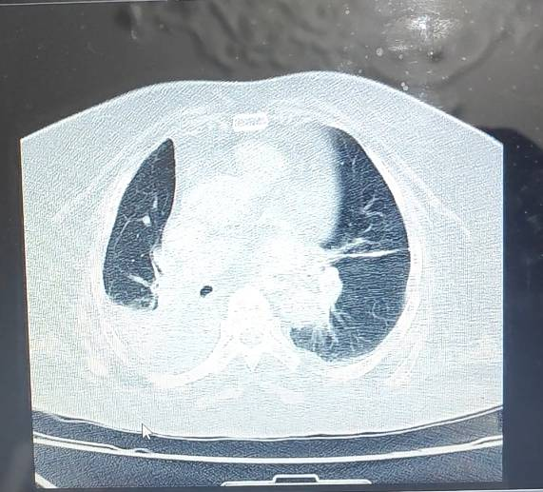
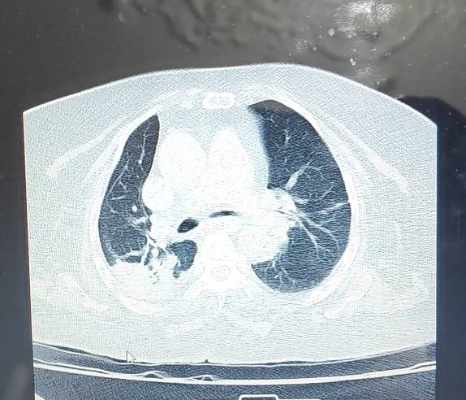
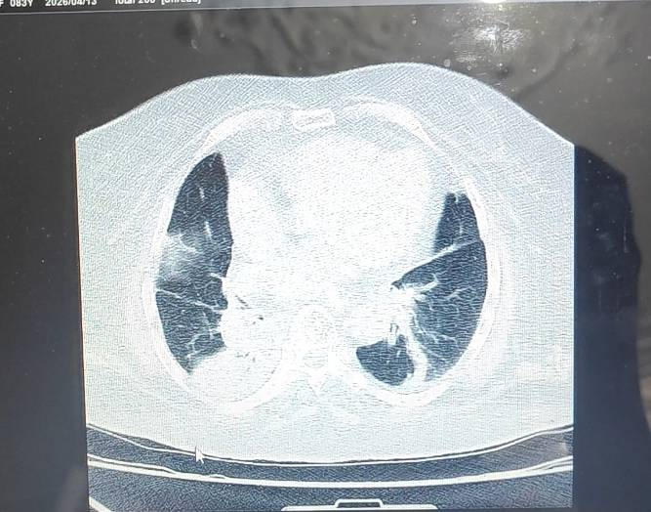
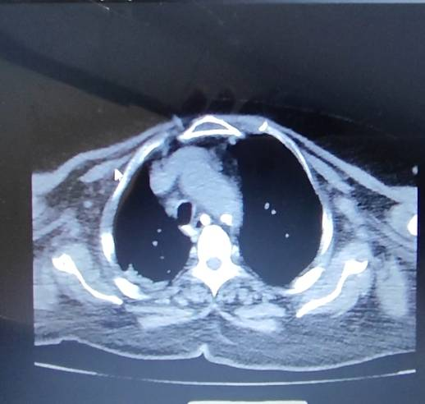
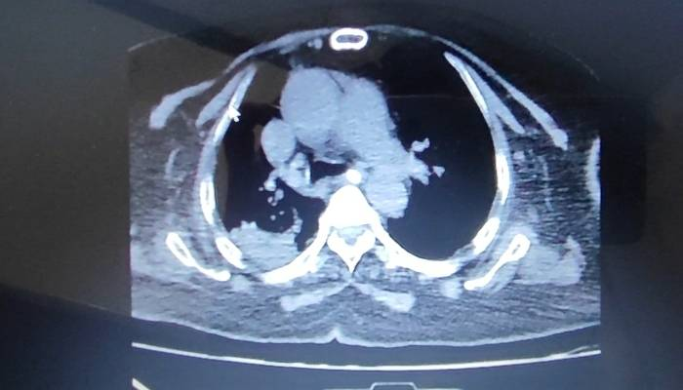
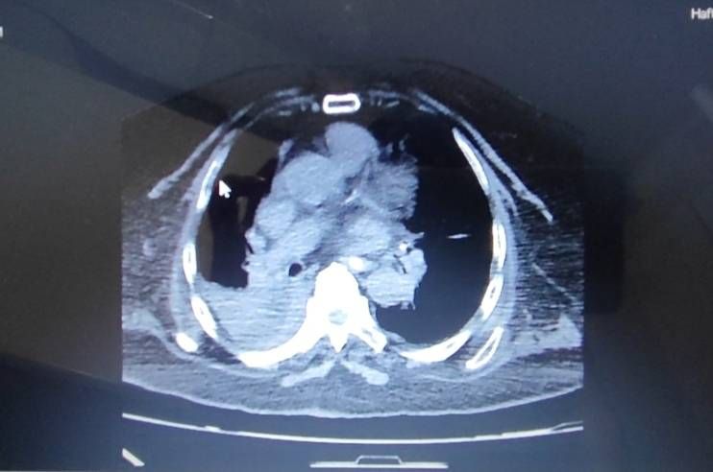
Chest ct 1405/01/12

Slide 13
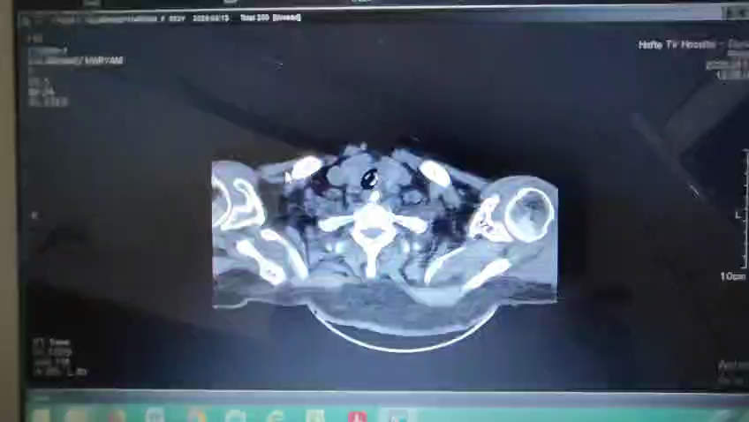
Chest ct video. 1405/01/12

Slide 14
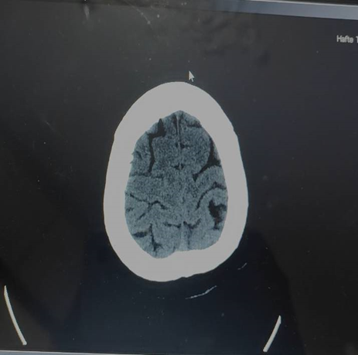
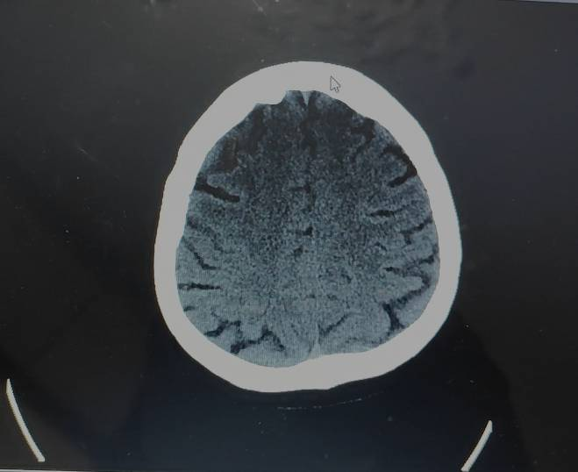
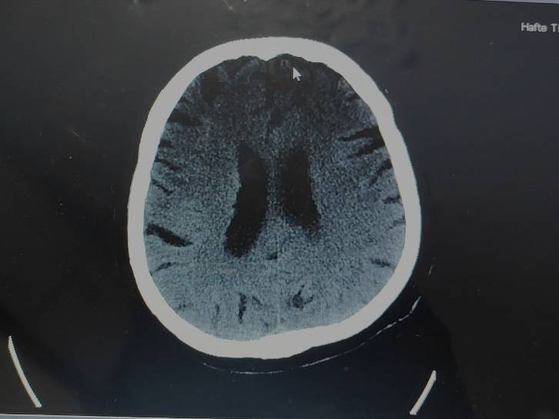
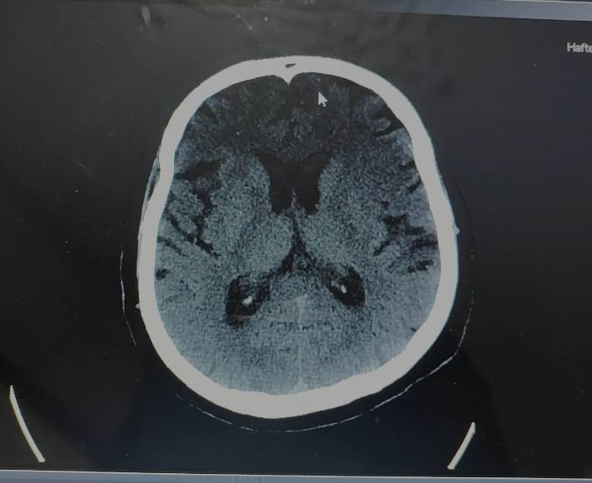
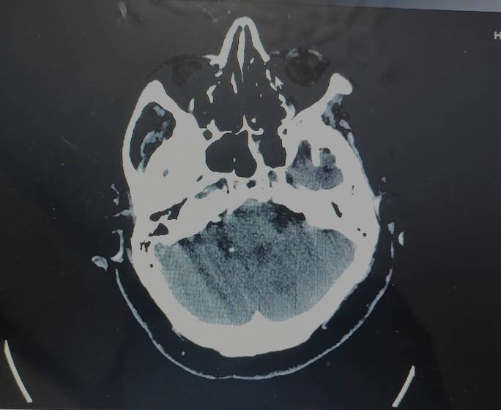
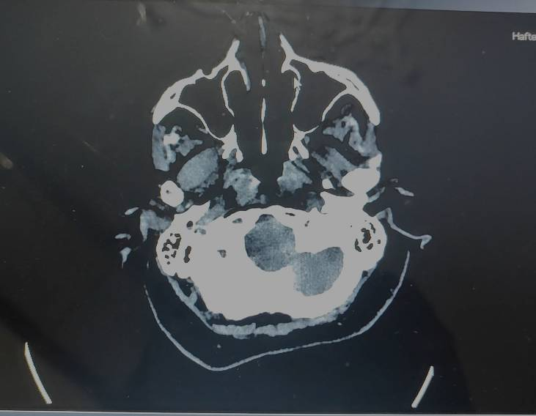
Brain ct 1405/01/19

Slide 15
?
In a patient with this clinical history and inability to wean from mechanical ventilation, what differential diagnoses should be considered?

Slide 16
Step2

Slide 17
LAB
WBC | 13.9
RBC | 3.95
HB | 11
HCT | 35.6
MCV | 90
MCH | 27.8
MCHC | 30.9
PLT | 172
SEG | 85.1
LYM | 9.9
Mixed | 5
RDW | 15.2
PDW | 12.5
MPV | 10
P.LCR | 26.3
ESR | 14
PT | 15.1
PTT | 33.1
INR | 1.1
PH | 7.41
PCO2 | 36.6
HCO3 | 22.8
O2SAT | 99.5
BE | -1.4

Slide 18
LAB
AST | 54
ALT | 74
ALK | 165
T Bili | 2.6
D Bili | 1
Alb | 3.4
CPK | 147
LDH | 1247
CPK MB | 38
Ca | 9.2
P | 0.9
Na | 137
K | 3.6
Mg | 1.9
BUN | 47
Cr | 0.7
LACTATE | 6.9
CRP | 15

Slide 19
Initial management
Meropenem 1 g TDS
Vancomycin 1 g BD
Hydrocortisone 100 mg TDS
Electrocardiography (ECG)/Echocardiography
Chest X-ray (CXR)
Bilateral lower extremity arterial and venous color Doppler ultrasonography
Neurology consultation
Infection disease consultation

Slide 20
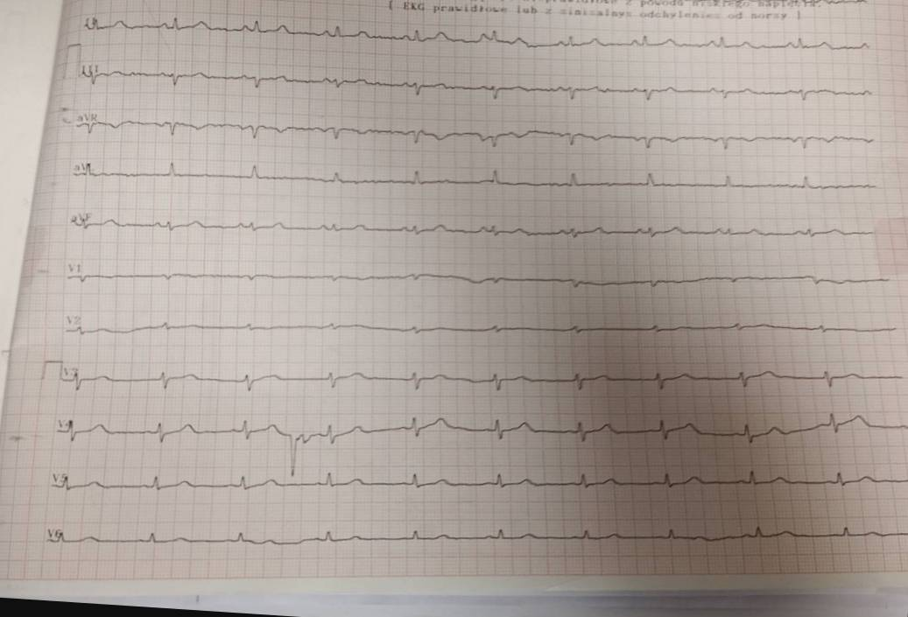
ECG

Slide 21
Echocardiography
Normal LV size and Normal systolic function (EF=55%).
No RMA at rest, Mild LVH.
Normal RV size and Normal systolic function.
Thickened MVLs, mild MR, no MS.
Thickened, Calcified tricuspid AVLs, no AS, Mild to Moderate AI.
Normal IVLs, mild TR, no TS.
Normal PVLs, trivial PI, no PS.
Normal IVC size and <50 collapsibility.

Slide 22
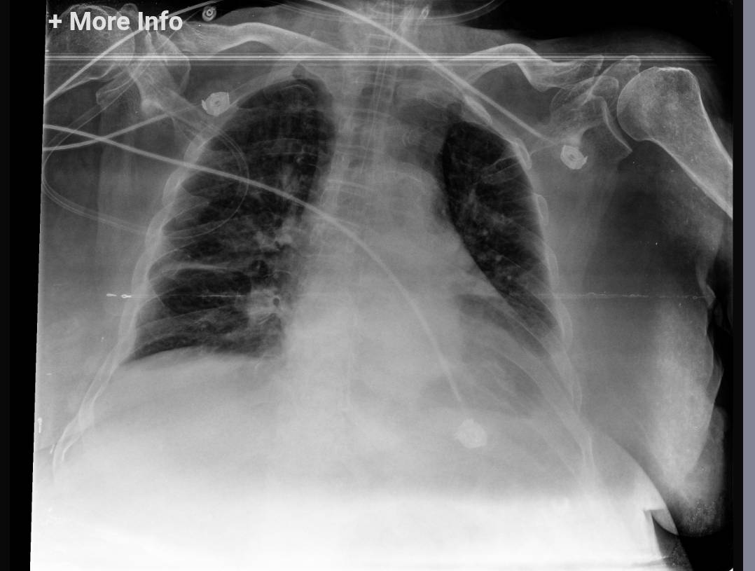
CXR

Slide 23
Disease course
According to neurology consultation
The patient is awake and alert and is able to maintain eye contact.
The pupils were normal in size and reactive to light.
Extraocular movements:NL
Muscle power:4/5 symmetric
Plantar reflex:extensor in right side/ NL in left side
On May 7 (17 Ordibehesht), due to prolonged intubation, the patient underwent tracheostomy via PDT (percutaneous dilatational tracheostomy).

Slide 24
Disease course
Due to a positive sputum culture for Pseudomonas
aeruginosa (02/15), the patient’s antibiotic regimen was changed to colistin ( 4.5 gr BD )and meropenem( 1gr TDS)

Slide 25
Given the improvement in the patient’s level of consciousness, a swallowing therapy consultation was requested, and the patient was assessed on multiple occasions over several consecutive days. The patient was still unable to swallow, and continuation of nasogastric (NG) tube feeding was recommended.
On the other hand, despite the improvement in consciousness, the patient remained ventilator-dependent, and several attempts at weaning from mechanical ventilation were unsuccessful.

Slide 26
In the next step(12APRIL), the patient underwent Flexible nasal bronchoscopy evaluation with methylene blue for assessment of swallowing function, which demonstrated that she still lacked adequate swallowing ability.
For further evaluation and to identify the cause of the respiratory dysfunction, Bilateral diaphragmatic ultrasound revealed severely decreased excursion on the right hemidiaphragm and complete paralysis of the left hemidiaphragm.
An EMG/ NCV study was requested by neurology; however, it was not feasible due to the patient’s condition.

Slide 27
LAST STEP

Slide 28
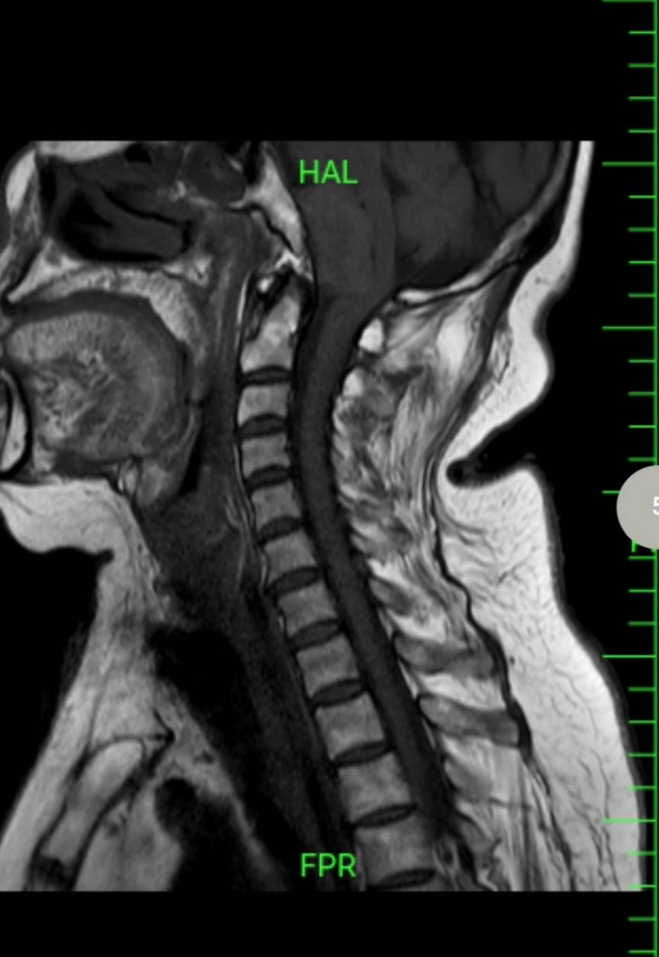
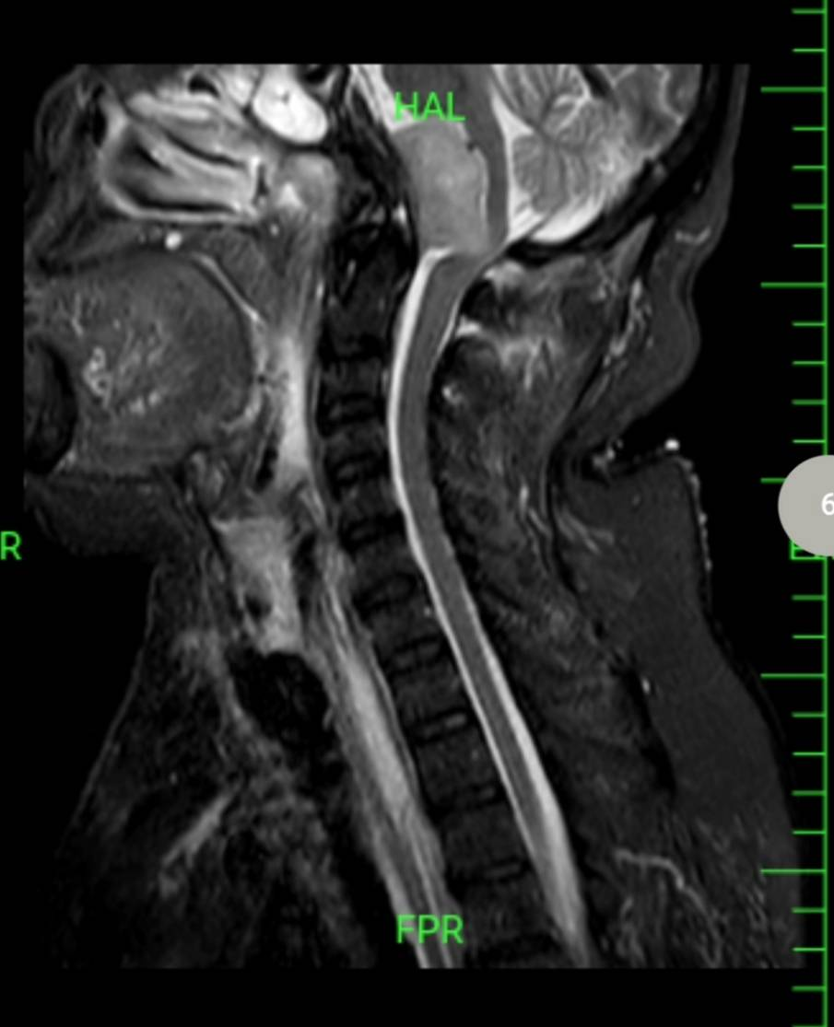
BRAIN MRI 1405/02/28

Slide 29
MRI REPORT
Senile degenerative changes and cortical atrophy are evident. Mild dilatation of all the ventricles is seen.
High signal foci in T2 W / FLAIR images are noted within the white matter of both cerebral hemisphere and in periventricular regions that are suggestive of ischemic lesions consistent with small vessel disease.
Small high T2 / FLAIR lesion diffusely in both hemispheres in favour of non specific findings is noted.
There is extra axial mass in the prepontine region showing intermediate T2 signal intensity and low T1 signal intensity with post contrast enhancement and no diffusion restriction.
The mention mass has significant mass effect on the medulla and lower pons with associated hydrocephalus and dilatation of the cisterna magna.
The findings are suggestive of meningioma with metastasis considered a less likely in ddx.

Slide 30
Final Diangosis:
An extra-axial mass lesion was identified in the prepontine region, most consistent with a meningioma.

Slide 31
According to the MRI report and repeat neurology evaluation, the patient’s symptoms, including respiratory and swallowing difficulties, are explainable by a hyperintense mass lesion causing a mass effect on the cervicomedullary junction.
Ultimately, based on neurosurgical consultation, the patient was deemed a candidate for surgical resection of mass.

